Slide 1
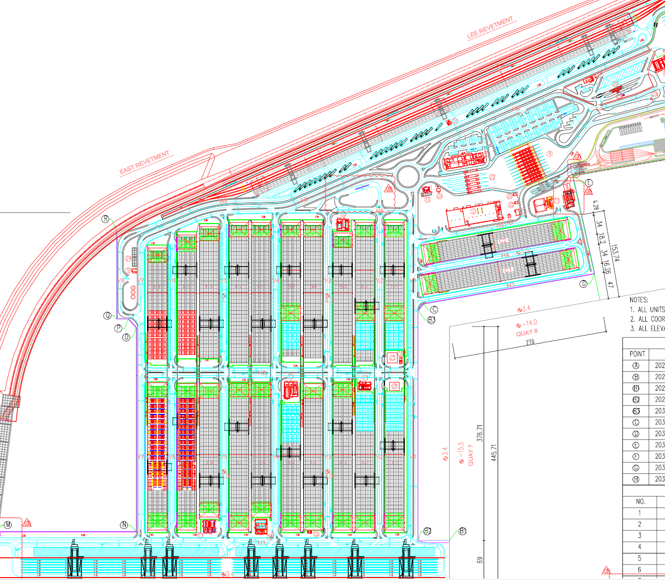
No. | AREA | SYSTEM NAME | Unit
1 | C1 C2 Area | C1 | 1293
2 | Road V5-1 | R1 | 438
3 | Block A7 | A7 | 569
4 | Block A8 | A8 | 199
5 | Road V5-2 | R2 | 224
6 | Block B8 | B8 | 41
7 | Block B3 | B3 | 360
8 | Rail Way | R3 | 1252
9 | Fuel station | F1 | 88
10 | OutGate | G1 | 38
11 | Quay 6 | Q1 | 21
12 | PARKING | P1 | /
Total |  |  | 4523
9
12
10
7
6
1
5
12
4
2
3
11

Slide 2
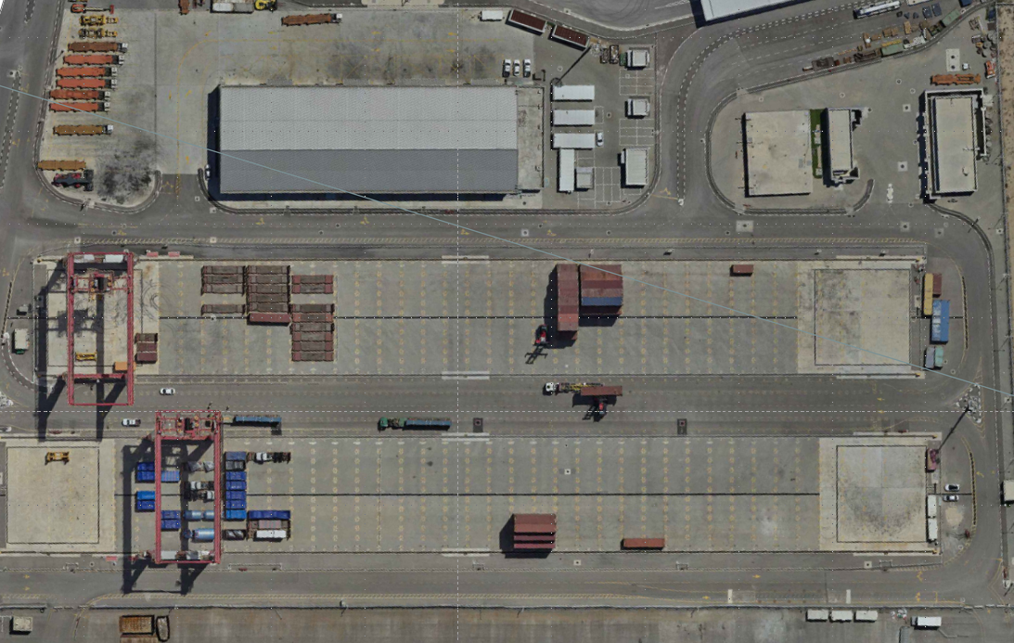
1.STORAGE PLAN FOR C1
9.2*200
OOG
34*150
18*100
52*135
OOG
9.6*150

Slide 3
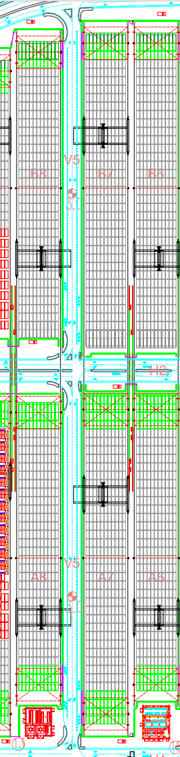
2.STORAGE PLAN FOR R2&B8
34*35
Brand | Model | Unit | Parking size for each car（m） | AREA
HMC | VENUE | 224 | 4.4*2.2 | R2
HMC | VENUE | 41 | 4.4*2.2 | B8
B8
B7
14.5*250
(358)

Slide 4
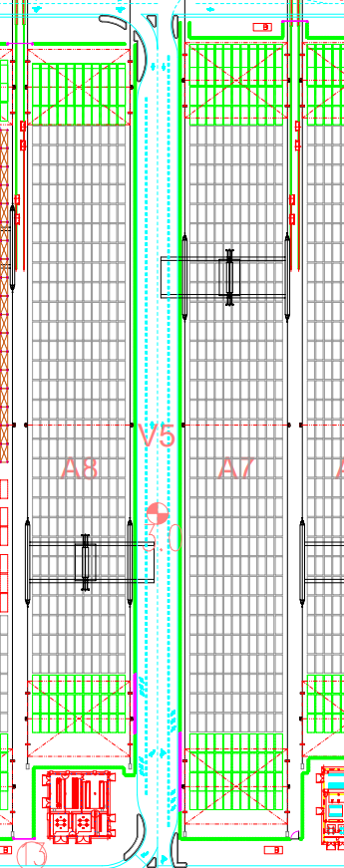
3.STORAGE PLAN FOR Road R1/A7/A8
Brand | Sequence | Model | Unit | Parking size for each car（m） | AREA
KIA | 1st | STONIC | 211 | 4.5*2.2 | A7
KIA | 2nd | NIRO HEV | 358 | 4.7*2.2 | A7
KIA | 3rd | SELTOS | 199 | 4.7*2.2 | A8
KIA | 4th | PICANTO | 438 | 4.0*2.0 | V5-1
A7
34*100
34*270
14.5*270
A8
(358)

Slide 5
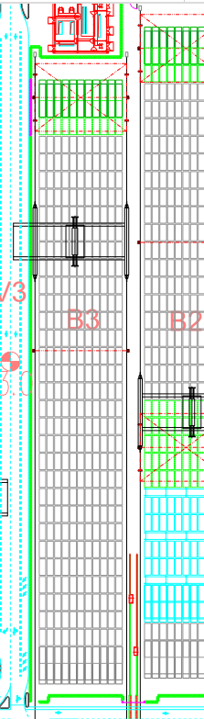
4.STORAGE PLAN FOR B3
Brand | Model | Unit | Parking size for each car（m）
HMC | ELANTRA HEV | 360 | 5.0*2.2
34*225

Slide 6
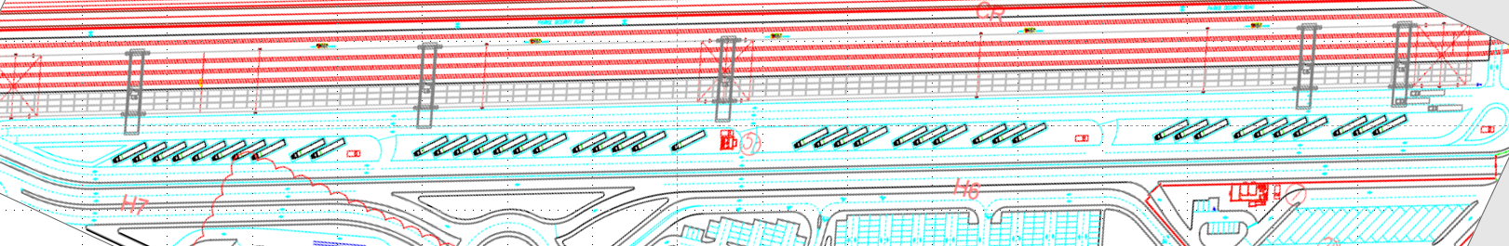
5.STORAGE PLAN FOR R3
32*450
Brand | Model | Unit | Parking size for each car（m）
HMC | KONA HEV | 718 | 4.5*2.2
HMC | KONA | 67 | 4.5*2.2
HMC | ELANTRA HEV | 327 | 5.0*2.2
CHERY | T19C | 100 | 5.0*2.2
DONGFENG | DONGFENG BOX | 40 | 4.5*2.2

Slide 7
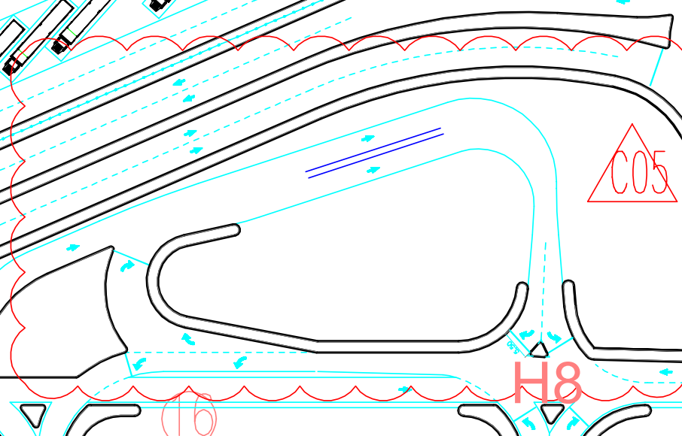
6.STORAGE PLAN FOR F1
1334 m ²
Brand | Model | Unit | Parking size for each car（m）
XIAOPENG | P71 | 55 | 5.4*2.5
HMC | GV60 | 4 | 5.0*2.4
HMC | GV70 | 3 | 5.0*2.4
HMC | GV80 | 11 | 5.4*2.4
HMC | G80 | 1 | 5.5*2.4
KIA | EV9 | 14 | 5.5*2.4

Slide 8
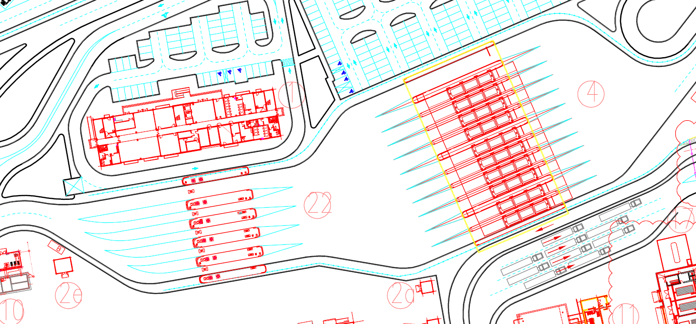
7.STORAGE PLAN FOR G1
3970m²
Brand | Model | Unit | Parking size for each car（m）
HIGER | KLQ6685GAEV | 7 | 13000*2650
 | KLQ6129GQ2 | 5 | 13000*2650
 | KLQ6125GEV3 | 20 | 13000*2650
 | KLQ6121YA | 5 | 13000*2650
GOLDEN DRAGON | XML6125CLE | 1 | 13000*2650

Slide 9
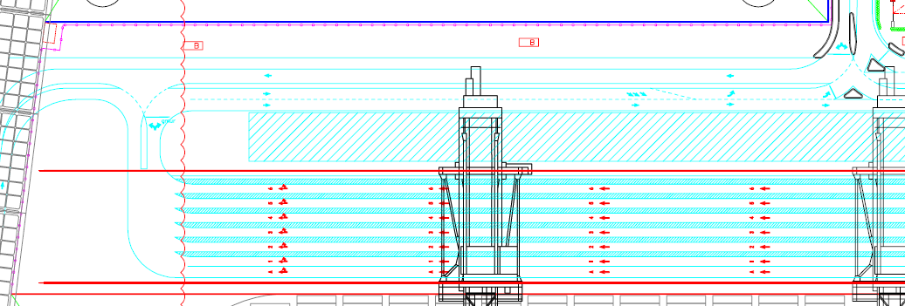
8.STORAGE PLAN FOR Q1
14*200

Slide 10
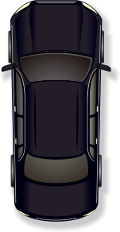
Parking standard
40cm
Execue according this rule
30cm

